Slide 1
Food and eating habits
Basic 2 Unit 5a

Slide 2
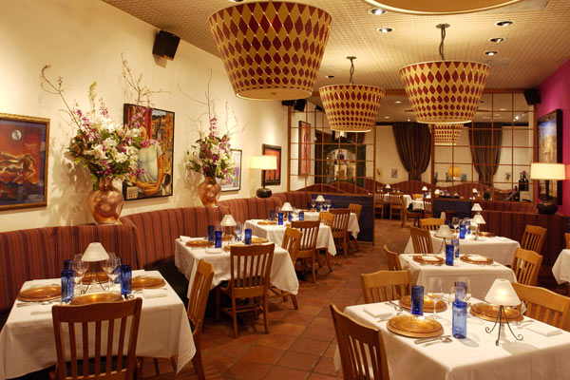
BREAKFAST

Slide 3
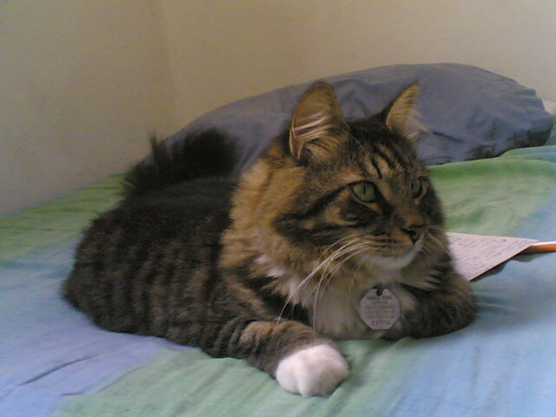
Koshka´s Café
Appetizers
Tomato soup Ocopa Russian Salad | $ 2.00 $ 3.00 $ 1.50
Main Course
Rice with chicken Spanish omelet Veggie Burger ☺ | $ 8.00 $ 3.00 $ 4.50
Drinks
Coffee water | $1.20 $1.00

Slide 4
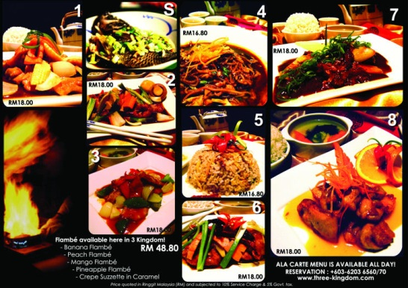

Slide 5
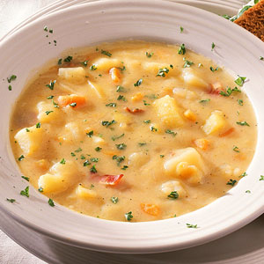
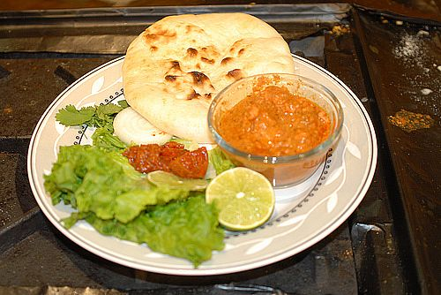
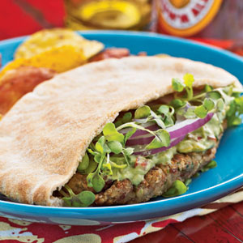
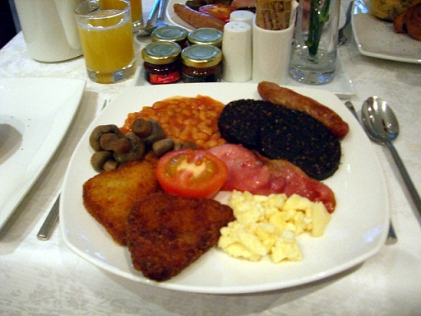
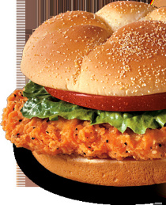
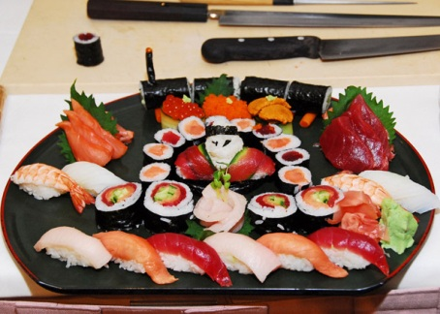
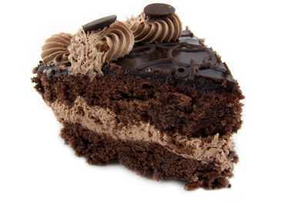
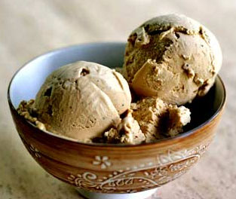
Pumpkin´s café
 | Potato soup $2.00 |  | Naan with hot sauce $1.00
 | Falafel $3.00 |  | English breakfast $10.00
 | Chicken sandwich $5.60 |  | Sushi Plate $18.00
 | Chocolate cake $2.00 |  | Ice cream $2.00

Slide 6
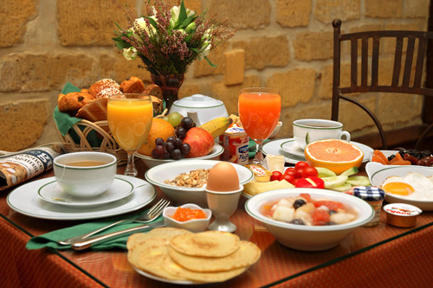
BREAKFAST

Slide 7
Cereal

Slide 8
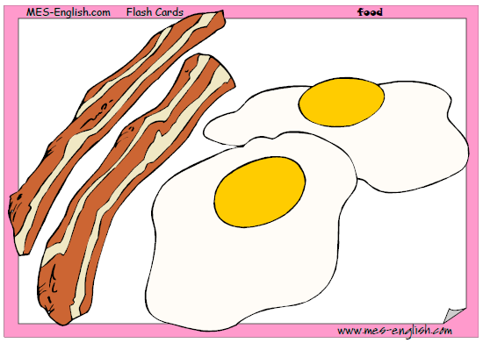
Bacon and eggs

Slide 9
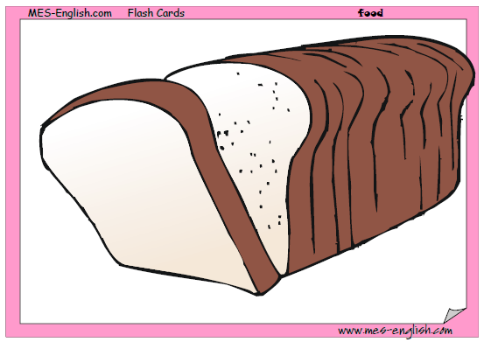
Bread

Slide 10
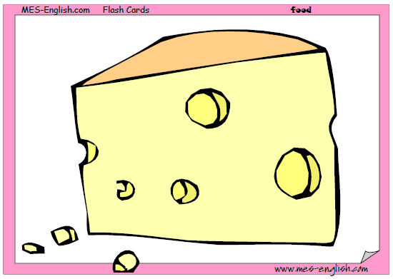
Cheese

Slide 11
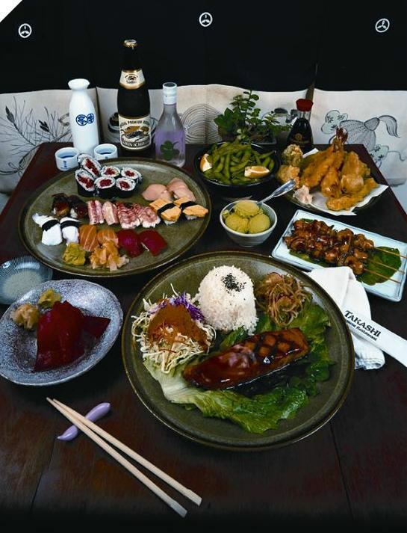
LUNCH & DINNER

Slide 12
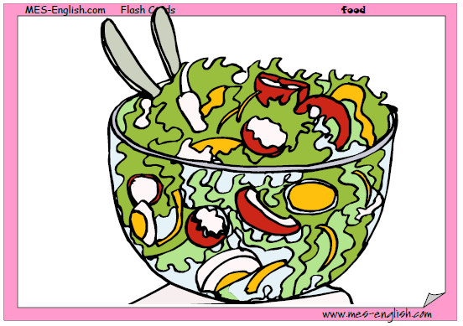
Salad

Slide 13
Spaghetti with tomato sauce

Slide 14


Slide 15
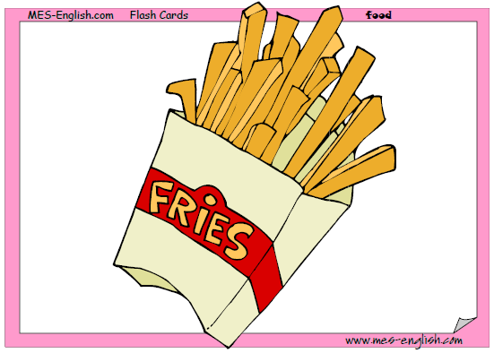
French
fries

Slide 16
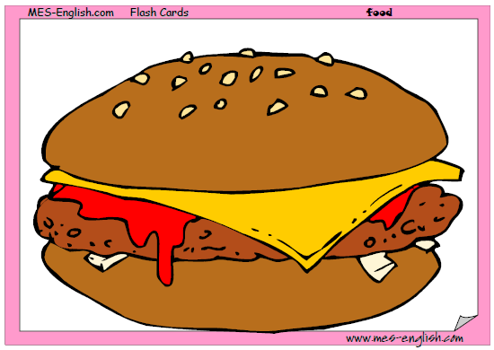
Hamburger

Slide 17
Pizza

Slide 18
Sandwich

Slide 19
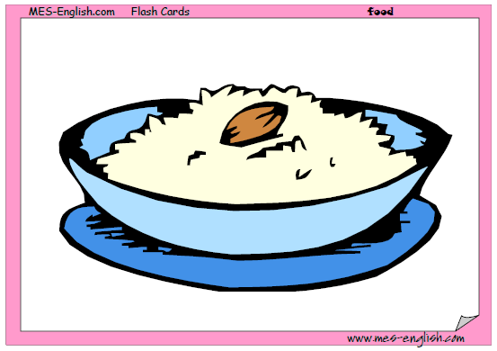
Rice

Slide 20
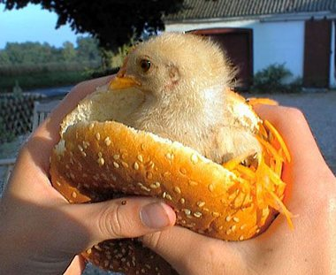
CHICKEN SANDWICH

Slide 21
Soda

Slide 22
Milk

Slide 23
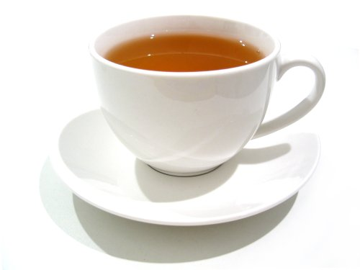
Tea

Slide 24
Water

Slide 25

Coffee

Slide 26
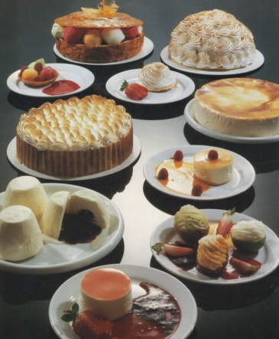
DESSERTS

Slide 27
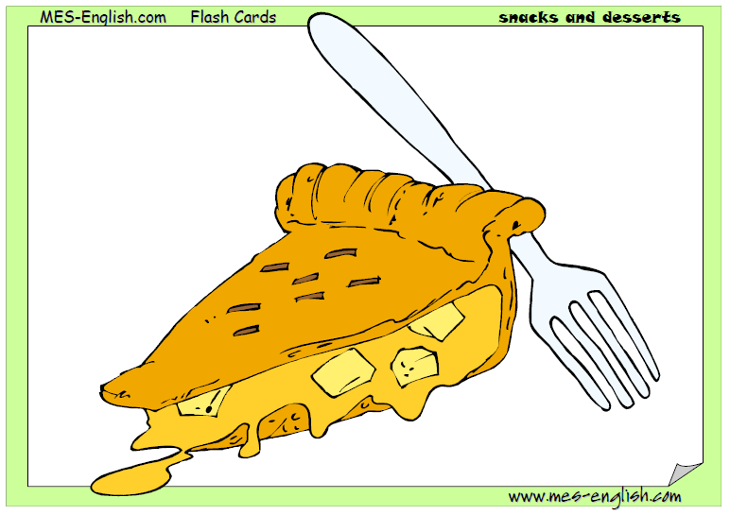
Pie

Slide 28
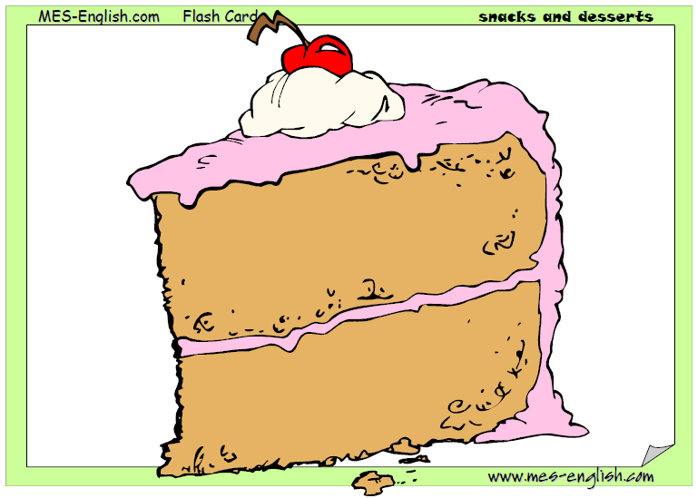
Cake

Slide 29
Cookies

Slide 30
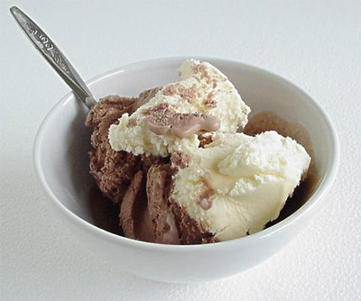
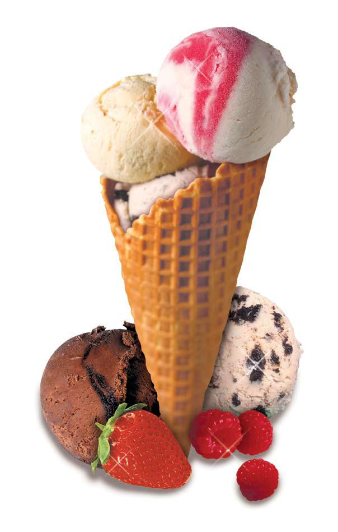
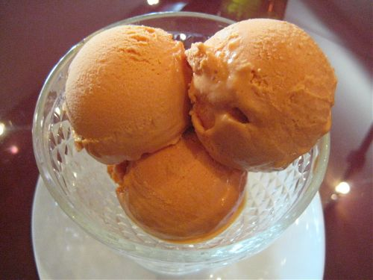
Ice cream

Slide 32
On most days, I have ________ for breakfast. __________ for lunch, and _________ for dinner.
+Yes, I do. I usually have _______.
-No, I don´t. I don´t like desserts.
My favorite food is ___________

Slide 33
What can I get you?
Anything to drink?
Positive
I´d like __________, please
Negative
Nothing, thank you.

Slide 34
http://www.youtube.com/watch?v=PiBX-ESFDF0&ob=av2e

Slide 35

Do you like _______?
+Yes, i do. I love it. :D
+yes, i like it a lot. ☺
+yes, it´s okay. :)
-No, not really. :/
-no, i can´t stand it. ¬¬

